Slide 1
Managing project and Teams
Lecture 5: Project Estimation

Slide 2
Retrospection
Recognize the purpose and importance of a project proposal in the project management process.
Identify and describe the key components of a project proposal
Types of contracts between the customer and the contractor
Measuring the success of proposal efforts
Notes:
After studying this chapter, students should know how to:
Develop relationships with customers and partners
Decide whether to prepare a proposal in response to a customer’s RFP
Create a credible proposal
Determine a fair and reasonable price for a proposal
Discuss how customers evaluate proposals
Explain types of contracts and various terms and conditions
Measure the success of proposal efforts

Slide 3
If you could have superpowers to accurately estimate software project timelines and resource requirements, which one would it be, and how do you think it would impact your development team's productivity?"

Slide 4
Key topics covered in this lecture

Slide 5
What we will cover in this lecture
Defining estimates
Distinguishing estimation from planning
Potential variation in projects
Benefits of accurate estimates
Factors to consider for estimation techniques
Notes:
After studying this chapter, students should know how to:
Develop relationships with customers and partners
Decide whether to prepare a proposal in response to a customer’s RFP
Create a credible proposal
Determine a fair and reasonable price for a proposal
Discuss how customers evaluate proposals
Explain types of contracts and various terms and conditions
Measure the success of proposal efforts

Slide 6
Introduction
Key activities in planning stage includes:
Understanding Project Objectives and Scope
Rescheduling of activities,
Resource planning Estimating costs
Develop project schedule
Risk Management Planning
Quality Planning- Quality Management Plan
Communication Plan
Stakeholder Management
Develop a Project Management Plan
Procurement Planning
Notes:
Define Project Scope
The project scope defines what needs to be done.
A project scope document includes many of the items contained in the project charter, RFP, or contractor’s proposal, but in much greater detail. The document is valuable for establishing a common understanding among project stakeholders regarding the scope of the project.
The project scope document usually contains the following sections:
Customer requirements define the functional or performance specifications for the project’s end product and other project deliverables.
It should also include or reference applicable technical specifications, standards, and codes that must be used and met regarding quality and performance of the project work and deliverables.
Statement of Work (SOW) defines the major tasks or work elements that will need to be performed to accomplish the work that needs to be done and produce all the project deliverables.
Deliverables are the products or outputs that the project team or contractor will produce and provide to the customer during and at the completion of the performance of the project.
Acceptance criteria for all project deliverables must be described in greater detail than what is stated in the project charter or request for proposal
Work Breakdown Structure (WBS) is a hierarchical decomposition of the project work scope into work packages that produce the project deliverables.

Slide 7
Estimates
Estimation is typically done in the early stages of project management, during the project planning phase.
An estimate is a prediction of how long a project will take or how much it will cost.
Estimation on software projects interplays with business targets, commitments, and control.
Target description the desirable business objective.
Commitments - promise to deliver defined functionality at a specific level of quality by a certain date.
Control – refers to the boundaries.
Notes:
The following is an example of a control --“We must limit the cost of the next release to $2 million, because that’s the maximum budget we have for that release.”

Slide 8
Estimation or Planning
Estimates form the foundation for the plans, but the plans don’t have to be the same as the estimates.
Key consideration that depends on accurate estimates:
Creating a detailed schedule
Identifying project critical path
Prioritizing functionality for delivery

Slide 9
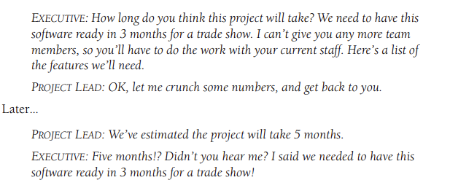
Typical Miscommunication of estimates

Slide 10
Good estimate
Accuracy with ±10% is possible, but only on well-controlled projects.
Chaotic projects have too much variability to achieve that level of accuracy.
Good estimation approach should provide estimates that are within 25% of the actual results 75% of the time (Conte, Dunsmore, and Shen 1986).
The assumption with estimates is that it is made by an impartial estimator
A good estimate is an estimate that provides a clear enough view of the project reality to allow the project leadership to make good decisions about how to control the project to hit its targets

Slide 11
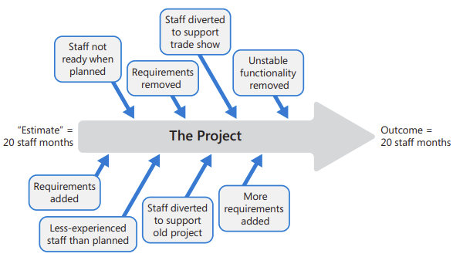
Project changes
Notes:
Events that happen during the project nearly always invalidate the assumptions that were used to estimate the project in the first place. F

Slide 12
Is it Better to Overestimate or Underestimate
Notes:
Don’t intentionally underestimate. The penalty for underestimation is more severe than the penalty for overestimation.
Address concerns about overestimation through planning and control, not by biasing your estimates.

Slide 13
Benefits of accurate estimates
Improved status visibility (Variance Analysis report)
Higher quality of work due to reduced stress
Better coordination with nonsoftware functions
Better budgeting and early risk information

Slide 14
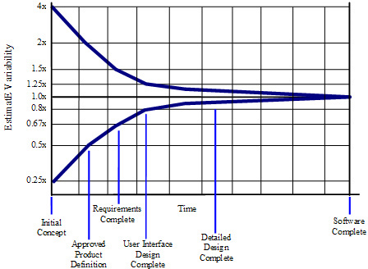
So where does estimation error come from
Cone of Uncertainty-The Cone of Uncertainty represents uncertainty that is inherent even in well-run projects. Additional variability can arise from poorly run projects—that is, from avoidable project chaos.
Notes:
Chaotic development process
Unstable requirements
Omitted Activities
Unfounded Optimism

Slide 15
Factors to consider for estimation techniques
Project size
Software Process Model
Programming Language
Notes:
Software Process Model-The percentage of requirements (Agile vs Sequential) they define early in the project compared to the percentage they define after construction is underway.

Slide 16
Estimation Techniques
Estimation techniques refer to the methods or approaches used to derive estimates for project parameters such as time, cost, and resources. Examples:
Count, compute and judge
Calibration and historical data
Individual Expert judgement
Decomposition and Recomposition
Proxy-based estimates
Group expert judgment
Estimation by analogy
Standardised Estimation
COCOMO (COnstructive COst Model)
Wideband Delphi
Notes:
Decomposition is the practice of separating an estimate into multiple pieces, and then recombining the individual estimates into an aggregate estimate. This estimation approach is also known as “bottom up,” “micro-estimation,” “module build up,” “by engineering procedure,”.
Estimation by analogy- Using previous estimation of similar projects.
Standardised Estimation- Based on particular project.
Wideband Delphi- It is a structured and iterative consensus-based estimation technique.

Slide 17
COCOMO
There are two categories of COCOMO: COCOMO 81 & COCOMO II
Basic calculation:
Effort (E) = a * (LOC)^b
a- is a constant that represents the effort required to produce one line of code (productivity constant)
LOC- Lines Of Code
b- is a constant that represents the scaling factor for the relationship between effort and the size of the project. Constant might be from historiacal data.

Slide 18
Estimation Types
Estimation types refer to the categorization of estimates based on their purpose, level of detail, and the stage of the project.
Type | Purpose | Accuracy
Rough Order of Magnitude | High-level estimate used early in the project to provide a rough idea of the project's scope and potential costs. | Has a wide range (-25% to +75%).
Budget Estimate | Used to establish the initial budget for the project. | Moderate accuracy with range smaller than ROM
Definitive Estimate | Developed when project requirements are well-defined
Parametric Estimate | Relies on statistical relationships between historical data | Moderate accuracy

Slide 19
Estimation challenges
Issues in estimating size
Numerous measures of size exist (Features, User stories, Requirements, Classes, Lines of Code (LOC))
Function Point -A function point is a measure of program size that can be used to estimate size in a project’s early stages.
Issues in estimating effort
Issues in estimating schedule
Do not shorten a schedule estimate without increasing the effort estimate.
Issues pertaining to planning parameters
Presentation style of estimates

Slide 20
Communicating estimates
Technical people are good in estimating but bad in defending their estimates.
Technical team member are generally introverts
Political influence
Negotiating an estimate vs negotiating a commitment

Slide 21
What if estimate is not approved
A Problem-Solving Approach to Negotiation-use principled negotiation
Separate the people from the problem.
Focus on interests, not positions.
Invent options for mutual gain.
Insist on using objective criteria.

Slide 22
Estimation tips
Be clear on targets, commitment and estimates
Avoid percentage confident estimates
Be sure the ranges you use in your estimates don’t misrepresent your confidence in your estimates.
Compare actual performance to estimated performance so that you can improve your individual estimates over time.

Slide 23
Estimate Activity Costs
The total project cost is often estimated during the initiating phase of the project, or when the project charter or a proposal is prepared.
Elements
Labor
Materials
Equipment
Facilities
Subcontractors and consultants
Travel
Contingency
Good Practices
Have the person responsible estimate costs
Use historical data to inform current project
Be reasonable and realistic
Estimate near-term activities more accurately
Elaborate other costs as additional information known
Notes:
The estimated cost for each specific activity can include the following elements:
Labor: Estimated costs for the various classifications of people who are expected to work on the project
Are based on the estimated work time (not necessarily the same as the activity estimated duration) and the dollar labor rate for each person or classification
Materials: Are the estimated costs of materials that the project team or contractor needs to purchase for the project
Equipment: The equipment that must be purchased as part of the project
Facilities: Special facilities or additional space for the project team; for security reasons; to store materials; or to build, assemble, and test the project end item (deliverable)
Subcontractors and consultants: Are outsourced when project teams or contractors do not have the expertise or resources to conduct certain project tasks
Travel: Travel (other than local travel) may be required during the project
Contingency (also referred to as reserves): Funds set aside to cover unexpected situations that may come up during the project
Such as items that may have been overlooked when the initial project scope was defined, activities that may have to be redone because they may not work the first time (redesigns), or a high probability or high impact risk that may occur
There are a number of good practices that project managers should keep in mind when estimating costs
Have the person responsible for the task estimate costs
Use historical data to inform the current project because you can learn from past projects’ mistakes
Be reasonable and realistic
Estimate near-term activities as accurately as possible
Although, at the beginning of the project, it may not be possible to estimate the costs for all activities with a high degree of confidence regarding accuracy.
This is especially true for longer-term projects
Elaborate other costs as additional information becomes available

Slide 24
Aggregate Total Budgeted Cost (TBC)
Establish a TBC for each work package
Determine the process
Top-down
Bottom-up
If sum of initial estimates exceeds sponsor budget, then reduce costs and recalculate

Slide 25
Develop Cumulative Budgeted Cost (CBC)
Once a total budgeted cost has been established for each work package, the second step in the project budgeting process is to:
Distribute each total budgeted cost (TBC) over work package duration
Create the time-phased budget
Calculate cumulative budgeted cost
Provides a baseline against which actual cost and work performance are measured
Notes:
The cumulative budgeted cost (CBC) is the amount that was budgeted to accomplish the work that was scheduled to be performed up to that point in time

Slide 26
Actual cost
Once the project starts, it is necessary to keep track of actual cost and committed cost so that they can be compared to the CBC.
Actual Cost
Committed Costs
Compare Actual Cost (CAC) To Cumulative Budgeted Cost (CBC)

Slide 27
Analyze Cost Performance
Four cost-related measures
TBC – total budgeted cost
CBC – cumulative budgeted cost
CAC – cumulative actual cost
CEV – cumulative earned value
Evaluate Cost Performance Index (CPI - Measure of the cost efficiency with which the project is being performed.
Cost performance index = Cumulative earned value/Cumulative actual cost
CPI = CEV/CAC

Slide 28
Evaluate Cost Variance
Difference between the cumulative earned value of the work performed and the cumulative actual cost
Cost variance =
Cumulative earned value – Cumulative actual cost
CV = CEV – CAC

Slide 29
Estimating Cost on completion
FCAC = total budgeted cost (TBC) / cost performance Index (CPI)
FCAC = cumulative actual cost (CAC) + (total budgeted cost (TBC) – cumulative earned value(CEV))

Slide 30
How can you control costs?

Slide 31
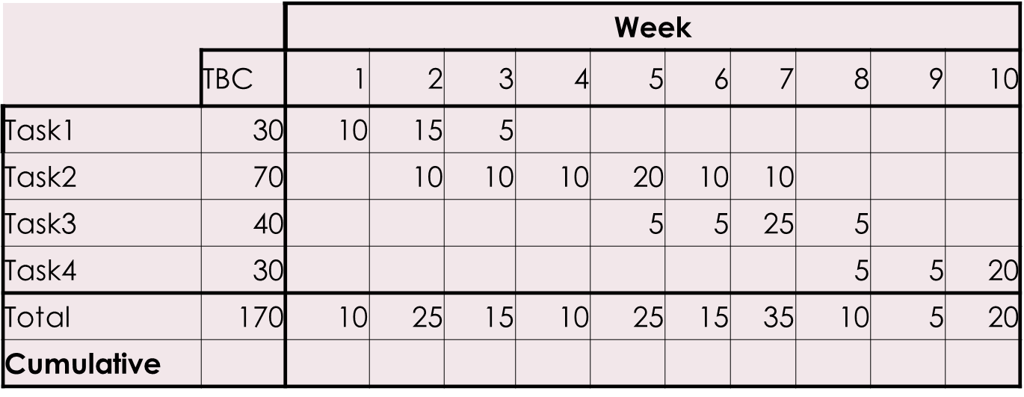
Exercise
The cost is in £.
What is the cumulative budgeted cost at the end of week 8?

Slide 32
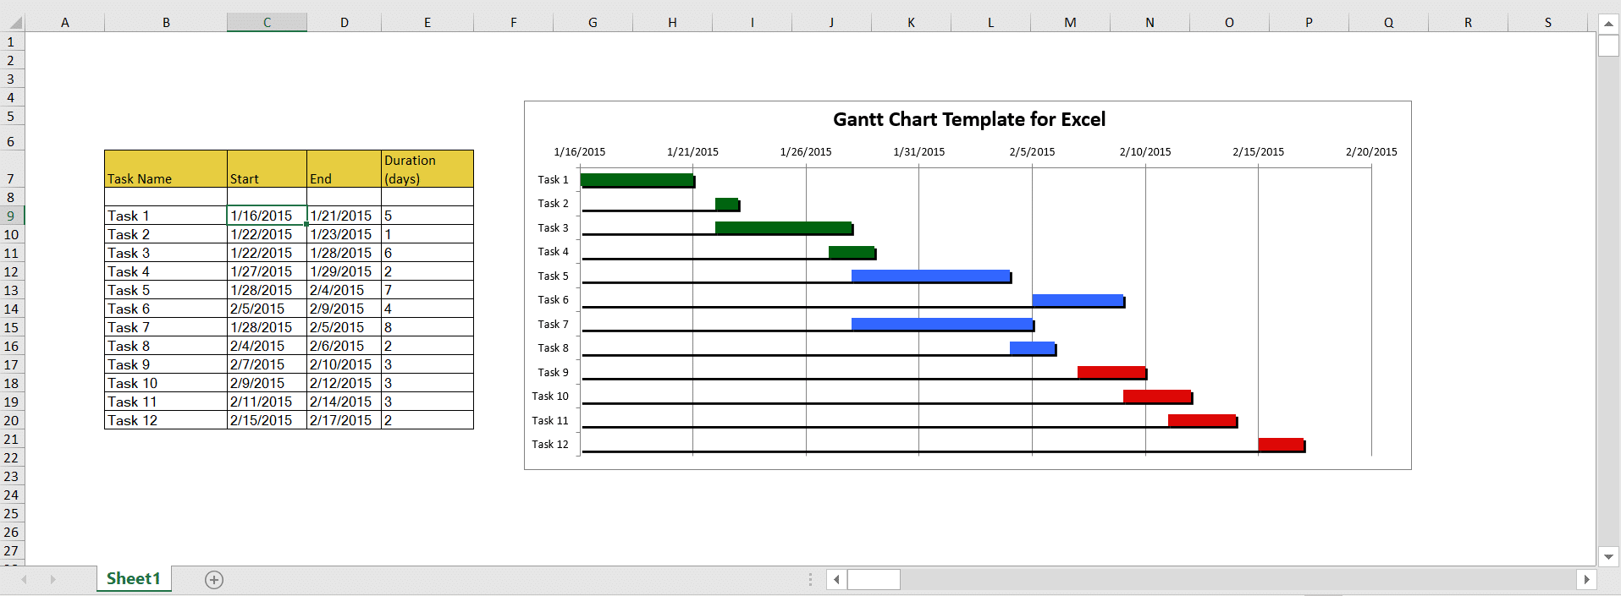
Project Schedules
A Schedule is a tool that tells you the tasks that have to be done, who must do them and when they must be done. Common tool used is a Gantt chart

Slide 33

How will no schedule impact a project?
ⓘ Start presenting to display the poll results on this slide.

Slide 34
Steps to develop a schedule
Identify major tasks and milestones
Identify all the smaller task and the order they must be done in to achieve the major task
Work with the planning team to estimate each task’s duration and start/end dates.
Identify which tasks depend on the completion of other tasks
Give each tasks the resources it needs
Write down any assumptions you made
Estimate the overall budget
Inform the sponsor and stakeholder and get their approval

Slide 35
The Shortest time or Specified due date
A project has two timelines:
The shortest possible time in which activities need to be completed.
The specific due date estimated by the project manager.

Slide 36
Using WBS in scheduling
In a WBS a project is broken down as follows:
The total project
Sub-projects
Milestones, that summarise the completion of an important set of work packages
Major activities – also called summary tasks
Work packages – also called tasks, activities or work elements
The levels in the WBS will help the PM control work at each level, identify resource needs and help with estimating costs.

Slide 37
Work packages: What are they?
A work package is the lowest level of the project activity that has both time and cost associated with it. Also the work package should have a deliverable so the the project manager will know whether it is completed or not.

Slide 38
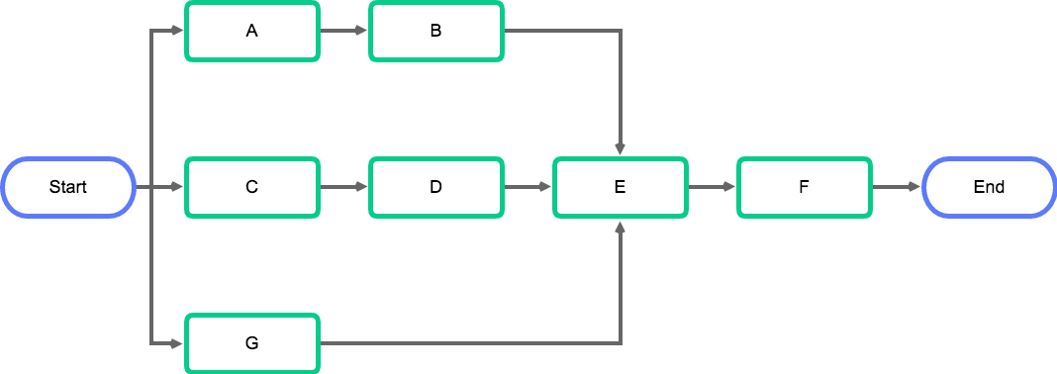
WHAT IS A NETWORK DIAGRAM?
It shows the path of the project
Lists starting and completion dates
Names responsible party for each task
Network diagrams show the workflow, not just the work.
Notes:
Show the sequence and relationships among activities necessary to finish a project.
Helps reduce uncertainty in the project by breaking it into small phases that have been properly thought out before starting the work

Slide 39
Five steps to create a network diagram
Step 1. List activities using the WBS.
Step 2. Establish the interrelationships between activities
Step 3. Identify the milestones that you want to specify
Step 4. Lay out the activities and milestones as a network.
Step 5. Review the logic of the network

Slide 40
Common Project Management Platforms
Primavera P6
Asana
Trello
Jira
TeamGantt
ClickUp

Slide 41
Summary

Slide 42
Key takeaway points
Understanding the importance of accurate estimation in software projects.
Factors influencing software estimation.
Types of estimates:
Estimation Techniques: COCOMO, Function Point Analysis, Consensus Based estimation, Agile Estimation techniques
Estimation challenges
Presentation of Estimates

Slide 43
References
Conte, S.D., Dunsmore, H.E. and Shen, Y.E., 1986. Software engineering metrics and models. Benjamin-Cummings Publishing Co., Inc..
Guide, P.M.B.O.K., (2017). A Guide to the Project Management Body of Knowledge (PMBOK® Guide), Project Management Institute.
McConnell, S. (2009) Software Estimation: Demystifying The Black Art, Microsoft Press
Ward, G.G., 2018. Effective project management: guidance and checklists for engineering and construction. John Wiley & Sons.

